Slide 1
Incremental Machine Learning Model with Scikit-Multiflow
Jack Xue
2022-07-15

Slide 2
What is Incremental Training?
Incremental learning is a method of machine learning in which input data is continuously used to extend the existing model's knowledge i.e., to further train the model. It represents a dynamic technique of supervised learning and unsupervised learning that can be applied when training data becomes available gradually over time or its size is out of system memory limits.
Algorithms that can facilitate incremental learning are known as incremental machine learning algorithms.

Slide 3
VFDT: Very Fast Decision Tree Algorithms
Fast: Process time is less the data read time.
No store for sample. Thus, the memory is proportional to the tree.
It only needs to see a sample once.
Anytime algorithm: After the first sample, the algorithm is ready for use and its quality increases with time.

Slide 4
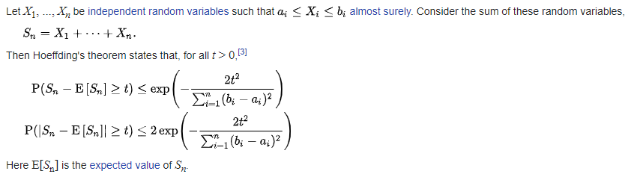
VFDT: Hoeffding Tree Algorithm
Hoeffding Bound
skmultiflow.trees.HoeffdingTreeClassifier
skmultiflow.trees.HoeffdingAdaptiveTreeClassifier

Slide 5
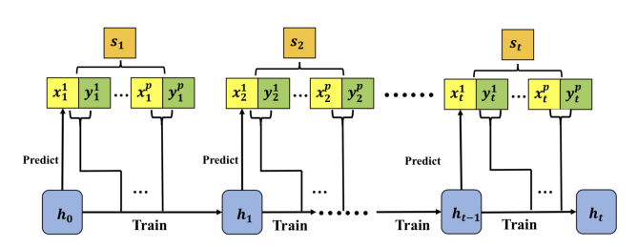
How Does Hoeffding Tree Algorithm Work?
We need three methods:
fit, predict and partial_fit

Slide 6
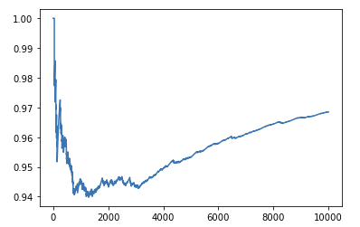
Model’s Input and Output
Stream Ensemble Algorithm for Input
skmultiflow.data.SEAGenerator
X: It generates 3 numerical attributes, that vary from 0 to 10.
Y: Depending on the comparison the generator will classify an instance as one of the two possible labels {0,1}.
Binary classification
Incremental accuracy = [sum(correctness_dist[:i])/len(correctness_dist[:i]) for i in range(1, nb_iters)]

Slide 7
Applications
Data analytics and big data processing: There is an increasing interest in single-pass limited-memory models which enable a treatment of big data within a streaming setting.
Robotics: Autonomous robotics and human-machine-interaction are inherently incremental, since they are open-ended, and data arrive as a stream of signals with possibly strong drift. Incremental learning paradigms have been designed in the realm of autonomous control , service robotics , computer vision , autonomous driving.
Image processing: Image and video data are often gathered in a streaming fashion, lending itself to incremental learning.
Automated annotation: One important process consists in the automated annotation or tagging of digital data. This requires incremental learning approaches as soon as data arrive over time.
Outlier detection: Automated surveillance of technical systems equipped with sensors constitutes an important task in different domains, starting from process monitoring , fault diagnosis in technical systems , up to cyber-security.

Slide 8
Reference
https://towardsdatascience.com/incremental-online-learning-with-scikit-multiflow-6b846913a50b
Mining high-speed data streams, KDD '00: Proceedings of the sixth ACM SIGKDD international conference on Knowledge discovery and data mining, https://doi.org/10.1145/347090.347107
Incremental Learning In Online Scenario, https://doi.org/10.48550/arXiv.2003.13191/
scikit-multiflow

